Slide 1
Git Exercise
DSPG 2022

Slide 2
Team Up
Fellows | Samantha | Leonard-Allen | Poonam | Nazmul | Nandini
#1 | Siddarth | Ari | Catherine | Christopher | Amanda
#2 | Taj | Josue | Milind | John | Chaudhry
#3 |  | Frankie | Riley | Rachel | Tay

Slide 3
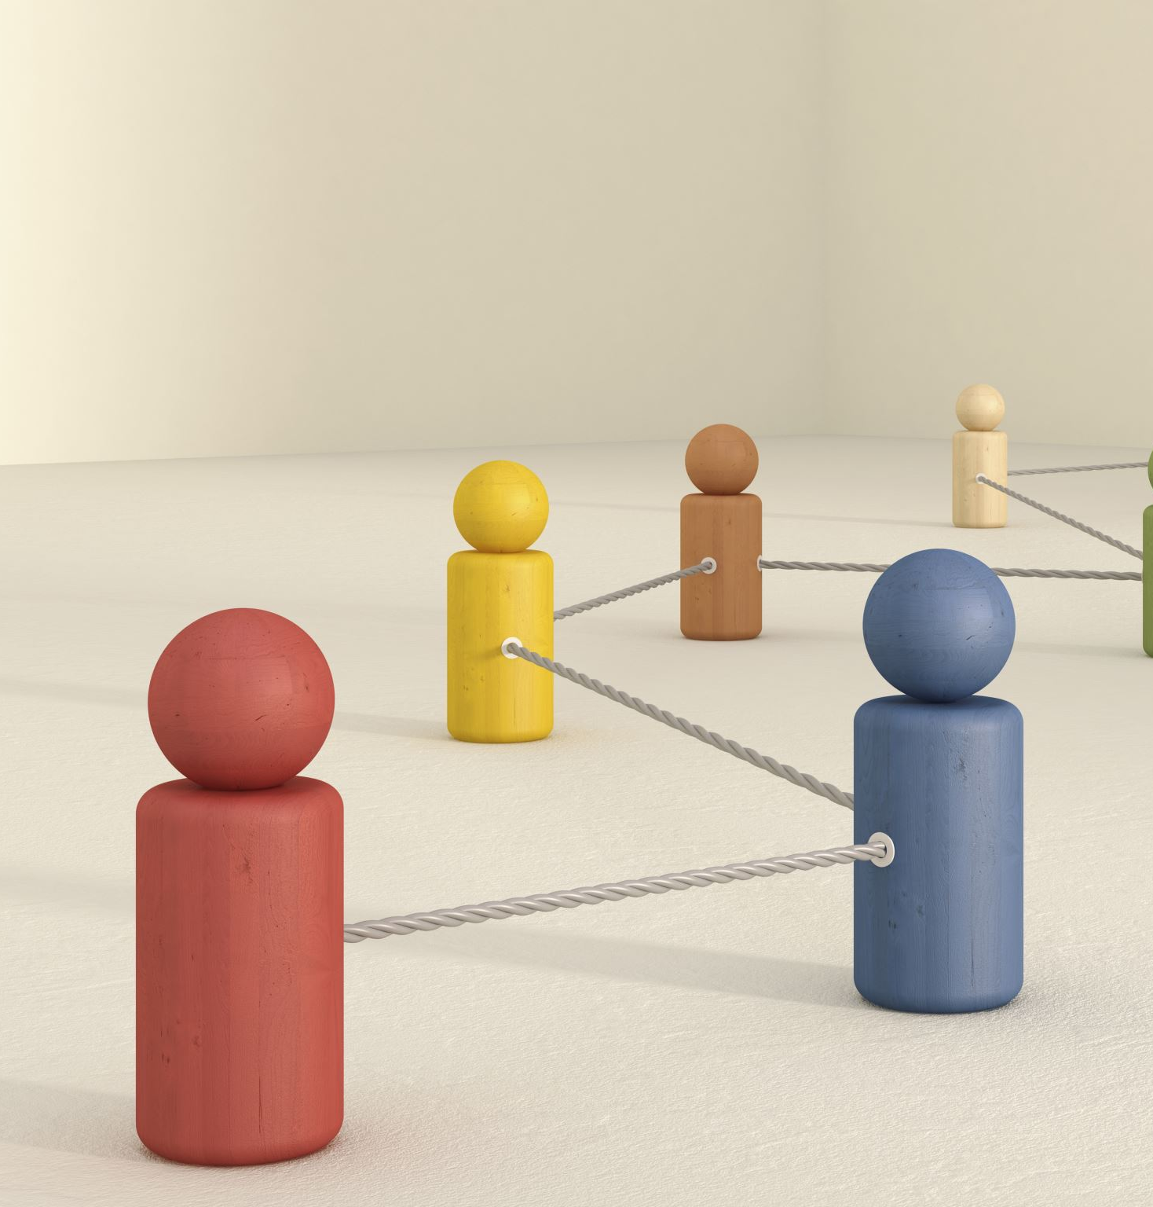
Plans
Set up repositories for team practice
Clone repository of your team
Branch
Stage, commit, pull, and push
Resolve a merge conflict
Team Exercise

Slide 4
Set up repositories
Fellows:
Create a new practice repository
Add readme file
Create folders such as “data” and “images” etc
Add interns as collaborators
Interns:
Go to your Email inbox and accept the invitation
Explore the GitHub page for the practice repository
Download the geo data and unzip it into the data folder

Slide 5
Clone repository of your team
Interns:
Log in to your GitHub account
Hint: https://ndporter.github.io/dspg-r-2022/02-project-intro/index.html#a-possible-solution
Go to GitHub and find the repository for your team practice
Note and examine the structure of the repo you have cloned. Check the names of folders and readme file
Clone the repository

Slide 6
Branch
Do a pull before branching
Add a new branch called “Yourname-branch”
Fellows check branches in GitHub

Slide 7
Stage, commit, pull, and push
Interns:
Keep in mind that you are in your branch now ☺
Make a new Text file and name it “Yourname-txt” (no spaces)
Put at least two paragraphs in the txt file
Save it
Go to the Git panel
Stage, commit with messages, pull, and push
Go to GitHub and check all the branches of repository

Slide 8

Resolve a merge conflict
Interns:
Let’s make a conflict!
Go to the #1 member’s branch, do a pull at the same time.
Everybody edits #1 member’s txt file. Change the second line of the code. (Assume you are doing serious coding). Save it.
First, #1 member: commit pull and push.
Then, #2 member: commit, pull, (error message) resolve conflict, pull again, and push.
Next, #3 member: commit, pull, (error message) resolve conflict, pull again, and push.
Last, #1 member, edit the txt file and change the second line, commit, pull, (error message) resolve conflict, pull again, and push.
Check the text file now and see the changes.

Slide 9
Team Up
Fellows | Samantha | Leonard-Allen | Poonam | Nazmul | Nandini
#1 | Siddarth | Ari | Catherine | Christopher | Amanda
#2 | Taj | Josue | Milind | John | Chaudhry
#3 |  | Frankie | Riley | Rachel | Tay

Slide 10
Team Exercise
Gather into your teams. Each team needs to use the repository you cloned. In this repo create a new R Markdown file. Only one per team. You need to work together and help each other.
Make sure the data that you will use in the RMarkdown file is in your repo and you know where to find it. (You can use the code and data from the training by Dr. Porter to help you but you need to copy it to a NEW r markdown file)
Everyone should make a geographic plot, histogram or line graph and put some words around those graphs/plots/images.
Interns: works on the Map and histogram or line graph. Add your name in the header etc, make sure your team have consistent format in the R markdown.
- Fellows: troubleshot and organize the repo

Slide 11
Work Flow
Interns: work in the branch for specific goals
Interns: stage, commit, pull, and push
Fellows: pull the branches back to main
Fellows: create different branches for different goals

